Slide 1
Chapter 4
Real cases of Heritage Marketing
MARHER - Heritage Marketing for competitiveness of Europe in the global market
Project Reference Number: 2019-1-DK01-KA202-060273
Key Action 2 - Cooperation for innovation and the exchange of good practices

Slide 2
REAL CASES
Glass House
Fog
CIU CIU
Museum of broken relationships
Little bee fresh
Rhanders
Inkaras
Pergalé
Androuet
Dubuisson
Columbus
Pinhais
MARHER - Heritage Marketing for competitiveness of Europe in the global market
Project Reference Number: 2019-1-DK01-KA202-060273
Key Action 2 - Cooperation for innovation and the exchange of good practices

Slide 3
1. Glass House
Country: Sweden
Type of organization: Museum
Type of activity: Digital History Communication
Limmareds Glasbruk, Sweden's oldest still operational glassworks, was established in 1740 and today is located near Glasets Hus. Limmared's glass house is a place of experiences, comprising a glass shop, a conservatory café, glassworks, and art exhibitions. The House of Experiences is, in a nutshell, a place where you may have a Glassblowing, a museum dedicated to the art of glassblowing, conferences and business events, and much more are all available.
Glasset Hus serves food and beverages, as well as a variety of activities. Glassworks and a museum make this a new intriguing retreat; displaying glass from the 17th century to the ABSOLUT bottle in a large exhibition.
The Glass House is operated by a non profit association and the organization has about 10 employees and added to that a big number of volunteers.
Website: http://glasetshuslimmared.se/
MARHER - Heritage Marketing for competitiveness of Europe in the global market
Project Reference Number: 2019-1-DK01-KA202-060273
Key Action 2 - Cooperation for innovation and the exchange of good practices

Slide 4
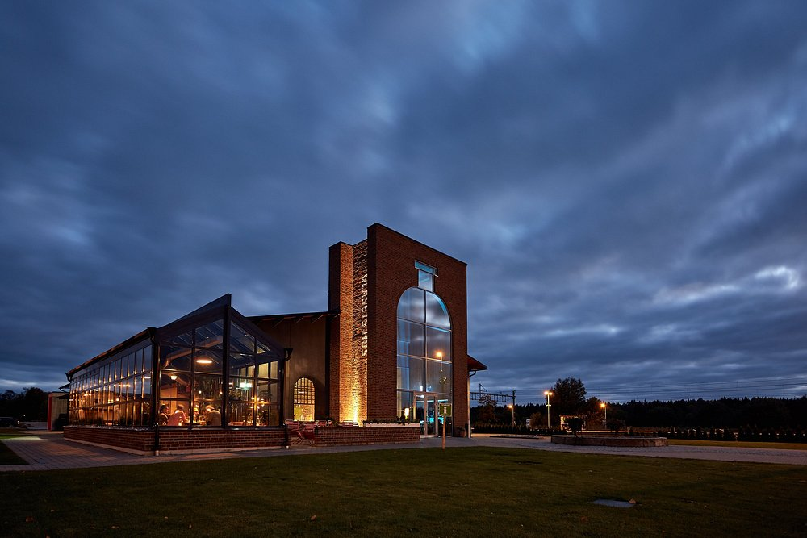
1. Glass House
Country: Sweden
Type of organization: Museum
Type of activity: Digital History Communication
The aim of the company through storytelling came when Glassets Hus discovered in 2017-2018 that the company had very little to offer children and young people. They then contacted a Swedish institution that is a leader in the field of "digital history communication." The creation of an app that is a great approach to impart knowledge in a completely new way and began in collaboration with them and also with financial assistance from the area and state of 7-8 hundred thousand Swedish kronor.
Website: http://glasetshuslimmared.se/
MARHER - Heritage Marketing for competitiveness of Europe in the global market
Project Reference Number: 2019-1-DK01-KA202-060273
Key Action 2 - Cooperation for innovation and the exchange of good practices

Slide 5
2. Johannes Fog
Country: Denmark
Type of business: Home & Design store
Type of activity: Anniversary events
Johannes Fog consists of one home and design store and nine building supply stores all of them located in North Zealand. Fog has employed Heritage Marketing in a variety of ways. Last year, Fog developed a new marketing strategy in which they clarified "who is Fog?" and "what do we want to provide to the market and for whom?“. Fog’s motto is "Fog is tenable (long-lasting)," which feels right given that they were founded in 1920 and are therefore more than 100 years old. On the occasion of their 100th anniversary they made a special logo (from the 1/1-2020) and began to pay more attention to the storytelling itself.
Website: https://www.johannesfog.dk/
MARHER - Heritage Marketing for competitiveness of Europe in the global market
Project Reference Number: 2019-1-DK01-KA202-060273
Key Action 2 - Cooperation for innovation and the exchange of good practices

Slide 6
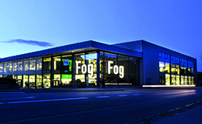
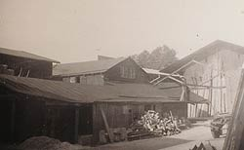
2. Johannes Fog
Country: Denmark
Type of business: Home & Design store
Type of activity: Anniversary events
Fog’s main goal with Heritage Marketing is to be visible on the market and bring attention to its unique position. In addition, to solidify its current market position, Fog will continue to focus and hit on quality, and its goods should last for a long period, as their slogan suggests.
Website: https://www.johannesfog.dk/
MARHER - Heritage Marketing for competitiveness of Europe in the global market
Project Reference Number: 2019-1-DK01-KA202-060273
Key Action 2 - Cooperation for innovation and the exchange of good practices

Slide 7
3. CIU CIU
Country: Italy
Type of business: Winery
Type of activity: Corporate autobiography
The corporate story of the Ciù Ciù winery took the form of an autobiography of its founder (corporate autobiography). The corporate autobiography is the life story of the founder of a company, told by himself, in which the family story tends to overlap until to the identification with the story of the company and where this life story is not a simple chronicle of facts but contains an ethical aspect and a vision. Therefore, not an impersonal story, proper to the organizational stories, but a life story; not a story told by a third person, such as a biography is, but a more empathic and personal count of a life in first person; not a simple chronology of facts but a description of the emotions and passions that accompanied them.
Website: www.ciuciuvini.it
MARHER - Heritage Marketing for competitiveness of Europe in the global market
Project Reference Number: 2019-1-DK01-KA202-060273
Key Action 2 - Cooperation for innovation and the exchange of good practices

Slide 8
3. CIU CIU
Country: Italy
Type of business: Winery
Type of activity: Corporate autobiography
The impact of the book can be summarized in five points:
A celebratory function. The book official presentation which took place at Offida's Serpente Aureo theatre on June 27, 2015, in front of an audience of about 400 people, including city and regional authorities, immediately carried out a celebratory function of the company's founder.
Community building. The publication of the Natalino Bartolomei autobiography was an opportunity for many company employees, especially young people, to learn about the company's history and the values on which it is based. Content generation for company communication.
The autobiography of the founder was also an opportunity to offer original content for digital corporate communication which, in the case of Ciù Ciù, is realized through a website and social media.
Strengthening corporate identity. It is no coincidence that the positive experience of the book has generated in Ciù Ciù Vini a new and more lively interest in the rural history of its territory. An interest thanks to which the company decided to invest in innovative heritage marketing projects.
Promotion of the territory. It was this discovery of an "exotic" and rural civilization, such as the sharecropping civilization, that generated a new interest in the territory in which the story is set.
Website www.ciuciuvini.it
MARHER - Heritage Marketing for competitiveness of Europe in the global market
Project Reference Number: 2019-1-DK01-KA202-060273
Key Action 2 - Cooperation for innovation and the exchange of good practices

Slide 9
3. CIU CIU
Country: Italy
Type of business: Winery
Type of activity: Corporate autobiography
The aim of using Heritage Marketing was to promote tourism and wine. The second reason is that they would like to offer tourists (especially foreigners) not only a beautiful place to visit and a good wine to taste but something that helps them to understand profoundly Italian culture, identity and story. Mezzadria Stories, in this sense, it is a kind of “key” trough which they can understand the landscape, local products and wine, their work-ethic and, perhaps, CIU CIU’s character. In short, the company would like to offer them an opportunity to experience Marche in an authentical way.
Website www.ciuciuvini.it
MARHER - Heritage Marketing for competitiveness of Europe in the global market
Project Reference Number: 2019-1-DK01-KA202-060273
Key Action 2 - Cooperation for innovation and the exchange of good practices

Slide 10
4. Museum of Broken Relationships
Country: Croatia
Type of organization: Interactive Museum
Type of activity: Storytelling through objects
The Museum of Broken Relationships is a worldwide crowdsourcing project with permanent exhibits in Zagreb and Los Angeles. The one-of-a-kind museum aims to act as a cathartic function, comparable to pain therapy: gathering emotions and giving them a physical home might help people overcome feelings of abandonment or guilt. Unlike typical museums, which frequently display and highlight noteworthy items or events by telling a "from above" story, this museum focuses on a community and daily narrative in which the protagonists are ordinary people's experiences and emotional reactions.
The institute's past and current touring exhibitions are a source of the collection's expansion, variety, and uniqueness. Material findings, Virtual museum on the internet, and Confessional are the three departments of the museum, which also includes a bistro, a store, and a café.
Website: www.brokenships.com
MARHER - Heritage Marketing for competitiveness of Europe in the global market
Project Reference Number: 2019-1-DK01-KA202-060273
Key Action 2 - Cooperation for innovation and the exchange of good practices

Slide 11
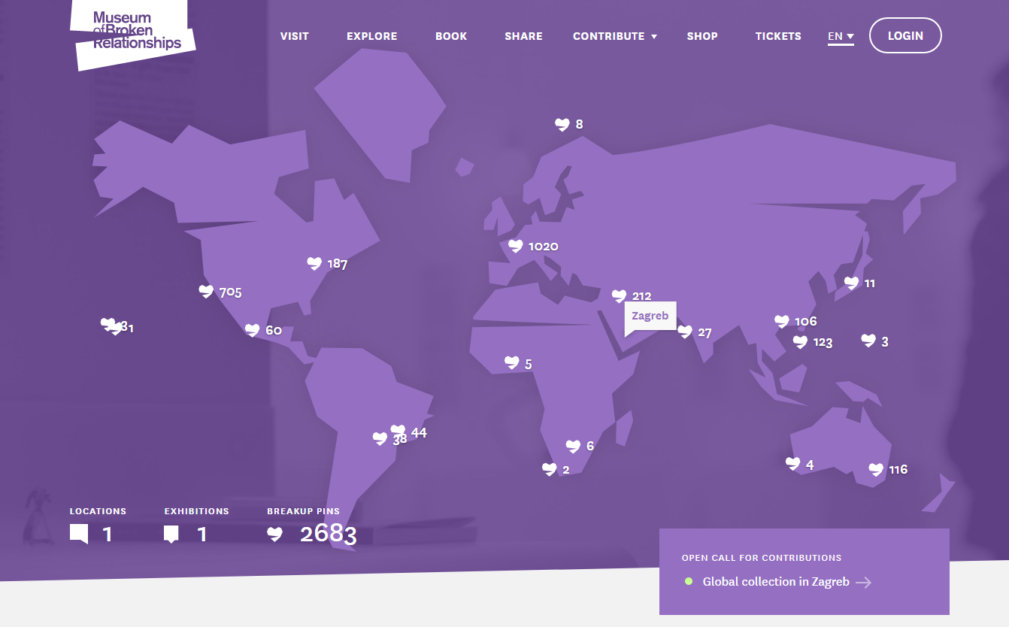
4. Museum of Broken Relationships
Country: Croatia
Type of organization: Interactive Museum
Type of activity: Storytelling through objects
In conferring the award in 2011, the EMF (European Museum Forum) jury noted that "The Museum of Broken Relationships fosters discussion and reflection not only on the fragility of human relationships, but also on the political, social, and cultural circumstances surrounding the stories told. The museum respects the public's ability to understand broader historical, social issues inherent in different cultures and identities and provides a catharsis for donors on a more personal level ”.
Website:www.brokenships.com
MARHER - Heritage Marketing for competitiveness of Europe in the global market
Project Reference Number: 2019-1-DK01-KA202-060273
Key Action 2 - Cooperation for innovation and the exchange of good practices

Slide 12
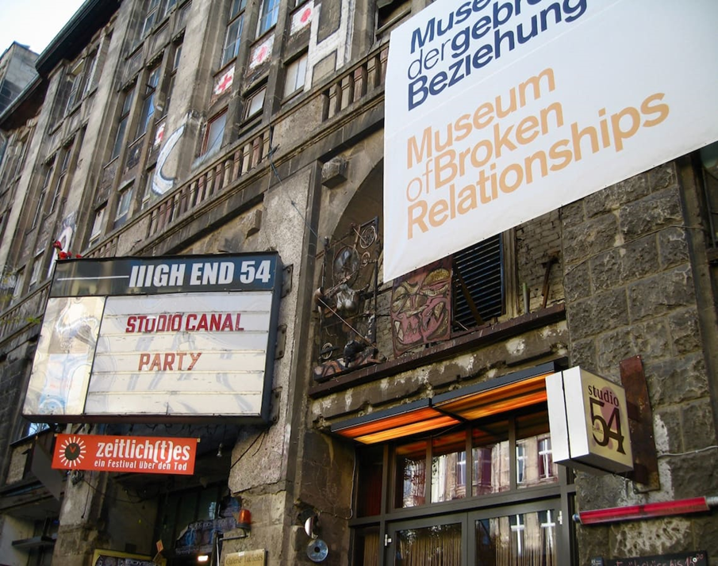
4. Museum of Broken Relationships
Country: Croatia
Type of organization: Interactive Museum
Type of activity: Storytelling through objects
The aim of using Heritage Marketing was to create a place that welcomed those who had marked the completed romantic relationships of anyone in the world. It is a concept that starts from the scientific assumption that objects (in a broader sense, matter as a whole) have integrated characteristics, a sort of 'hologram' of memories and emotions.
Website:www.brokenships.com
MARHER - Heritage Marketing for competitiveness of Europe in the global market
Project Reference Number: 2019-1-DK01-KA202-060273
Key Action 2 - Cooperation for innovation and the exchange of good practices

Slide 13
4. Museum of Broken Relationships
Country: Croatia
Type of organization: Interactive Museum
Type of activity: Storytelling through objects
The museum intends to create a space of 'safe memory' or 'protected memory', in order to preserve the tangible and intangible heritage of broken relationships. The ability to heal heart wounds by detaching (but not destroying it) from an object that symbolizes a breakup can mean a lot to those directly affected.
Website:www.brokenships.com
MARHER - Heritage Marketing for competitiveness of Europe in the global market
Project Reference Number: 2019-1-DK01-KA202-060273
Key Action 2 - Cooperation for innovation and the exchange of good practices

Slide 14
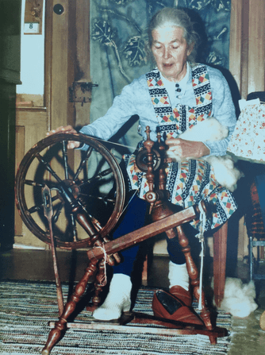
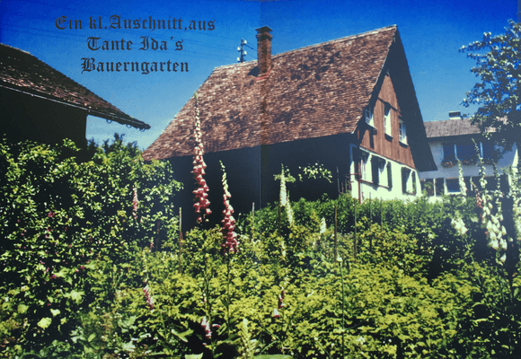
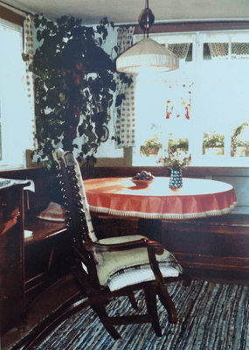
5. Little Bee Fresh
Country: Germany
Type of business: Beeswax Wraps Production
Type of activity: Creation of a narrative
The company uses the story of “Aunt Ida”, a relative of the founders, to tell about the origin of the idea, mission, product development and company itself. Thereby, a corporate heritage identity is transported by underlining the importance of inheritance and creating a multi-generational character. The emotional message style may create positive or negative emotions. In this case, the corporate heritage marketing may appeal to positive emotions in form of comfort in the past during times of great social change in the present.
Website: https://little-bee-fresh.de/tante-ida/
MARHER - Heritage Marketing for competitiveness of Europe in the global market
Project Reference Number: 2019-1-DK01-KA202-060273
Key Action 2 - Cooperation for innovation and the exchange of good practices

Slide 15
5. Little Bee Fresh
Country: Germany
Type of business: Beeswax Wraps Production
Type of activity: Creation of a narrative
The aim of using Heritage Marketing, accordingly to its founders is that: Aunt Ida is a role model to us, because she shows how an alternative approach to sustainability does indeed work: in her time, there was no plastic, and she was a self-supporter. All the more, storing groceries was a vital issue to her. This story relates to both our formation, and to our product, and it is a true occurrence. Our product is not novel, it has been tried and tested over decades. Storytelling is essential to marketing, that is why they tell this story. This is well received by our customers and the story helps in building trust to us, to the brand and to the product.
Website: https://little-bee-fresh.de/tante-ida/
MARHER - Heritage Marketing for competitiveness of Europe in the global market
Project Reference Number: 2019-1-DK01-KA202-060273
Key Action 2 - Cooperation for innovation and the exchange of good practices

Slide 16
6. Rhanders
Country: Denmark
Type of business: Glove and leather good manufacturer
Type of activity: Iconic products
The company was officially founded in 1811, in Randers, Denmark. It is an official deliverer to the royal family. In 2018, Rina Hansen, the current owner and CEO, took over the company.
In 2019, the company’s name changed from ”Randers Handskefabrik” to RHANDERS . The company is said to be amongst the oldest glove manufacturers, globally. Its headquarter and production is located in Randers, with a flagstore in Copenhagen.
Website: https://rhanders.com/
MARHER - Heritage Marketing for competitiveness of Europe in the global market
Project Reference Number: 2019-1-DK01-KA202-060273
Key Action 2 - Cooperation for innovation and the exchange of good practices

Slide 17
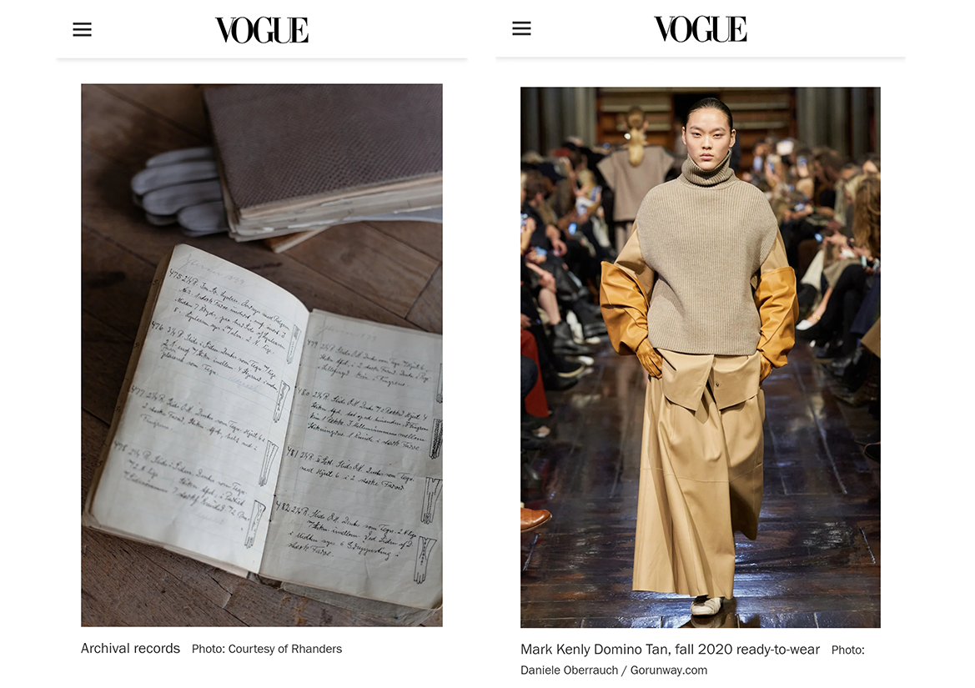
6. Rhanders
Country: Denmark
Type of business: Glove and leather good manufacturer
Type of activity: Iconic products
The aim of using Heritage Marketing in Rhanders, as explained by the current CEO is to preserve the heritage of the last remaining company on its kind in Europe, in her own words: . “My life mission with purchasing the company with dedicating my career to running it is to preserve the heritage and craftsmanship. I feel that it is a very important part of our history. Our company is the last one remaining in Europe, so this has to be preserved! We need to document our heritage, and then we also need to innovate, else we just become a museum. I need to make our brand desirable, and I think that telling stories about our culture and history helps our customers understand meaning and heritage behind it”.
Website: https://rhanders.com/
MARHER - Heritage Marketing for competitiveness of Europe in the global market
Project Reference Number: 2019-1-DK01-KA202-060273
Key Action 2 - Cooperation for innovation and the exchange of good practices

Slide 18
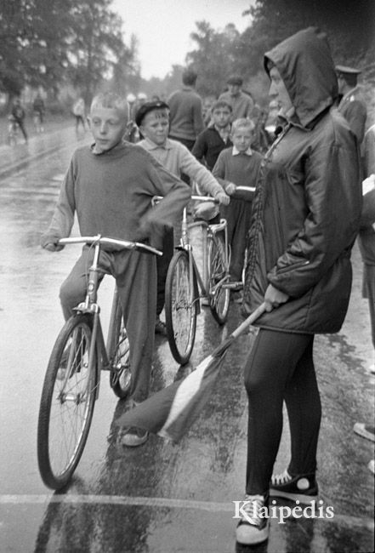
7. Inkaras
Country: Lithuania
Type of business: Production of canvas sneakers and other footwear
Type of activity: Brand restoration
The company was founded in 1933 and after a series of events was liquidated in 2012. The trademark rights were purchased in 2018 and the restoration/comeback process begun. The restoration process started with obtaining as much information as possible on the factory's 86-year existence. Various European countries were used to purchase old Inkaras footwear models. The firm now has a large variety of models ranging from the 1970s to the late 1990s. New models were introduced to the local market in 2019 and have proved highly popular among the locals. The company is developing its range of new shoes and is actively seeking development into other countries, since the brand is well-known in Eastern and Central Europe.
Website: www.inkaras.lt
MARHER - Heritage Marketing for competitiveness of Europe in the global market
Project Reference Number: 2019-1-DK01-KA202-060273
Key Action 2 - Cooperation for innovation and the exchange of good practices

Slide 19
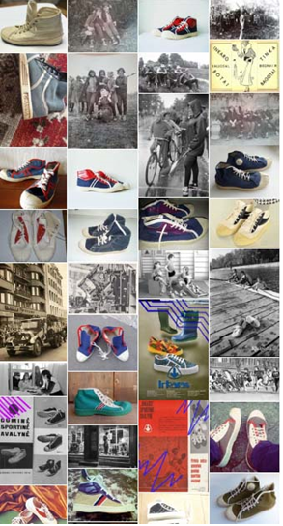
7. Inkaras
Country: Lithuania
Type of business: Production of canvas sneakers and other footwear
Type of activity: Brand restoration
The aim of using Heritage Marketing with inkaras was to go back to market: Inkaras sneakers, which were returned to the market in 2019 after many years, are adapted to the people of nowadays, but their design retains many authentic details. In order to succeed in creating comfortable, stylish shoes with history, it was important not only to be interested in people's memories for a long time, but also to collect the shoes that had already become legends. It was necessary to have the old pairs of sneakers that made it possible to decide, which details are inseparable from the Inkaras and to come up with ideas for the design of the new shoes.
Website: www.inkaras.lt
MARHER - Heritage Marketing for competitiveness of Europe in the global market
Project Reference Number: 2019-1-DK01-KA202-060273
Key Action 2 - Cooperation for innovation and the exchange of good practices

Slide 20
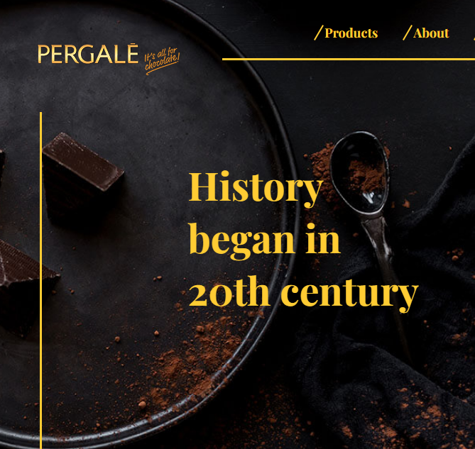
8. Pergale
Country: Lithuania
Type of business: Production of sweets and confectionary
Type of activity: Actualization of heritage products and recipes
The history could be called a history of Lithuanian chocolate production. It began in 1922, when the first confectionary factory in the country was established. In 1930, new owners have changed the factory name to FORTUNA and started to produce chocolate products.
In 1946, Lithuania made a strategic plan to modernize its confectionary production. As a result, in 1952 the most modern factory at the time – VILNIAUS PERGALĖ was established. From then on, the factory has grown steadily in both the local and international markets.
Long years of chocolate mastery helped us to build up a wide range of products: assorted chocolates, exclusive and premium chocolates boxes, chocolate bars, pralines, pomade or liqueur sweet chocolates, truffles, dragée and even more. Some of them still keep authentic secret recipes – the same as 50 years ago.
Website: http://www.pergale.lt/en/products/confections
MARHER - Heritage Marketing for competitiveness of Europe in the global market
Project Reference Number: 2019-1-DK01-KA202-060273
Key Action 2 - Cooperation for innovation and the exchange of good practices

Slide 21
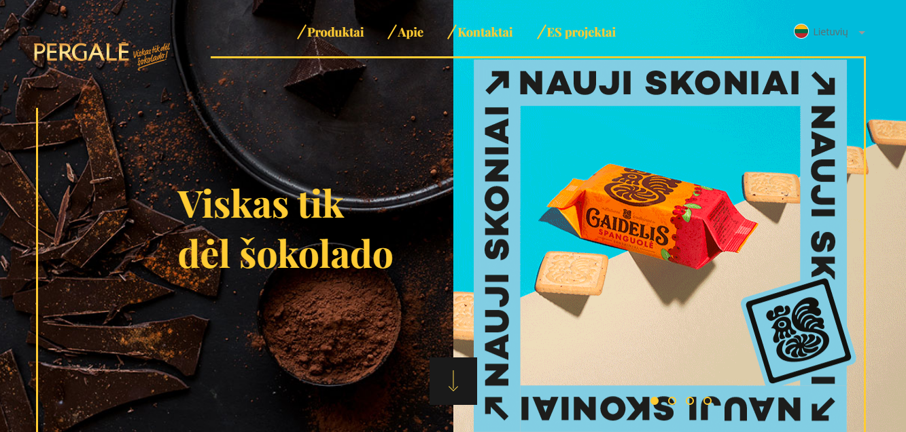
8. Pergale
Country: Lithuania
Type of business: Production of sweets and confectionary
Type of activity: Actualization of heritage products and recipes
Pergale products are recognized and highly valued in more than 35 countries worldwide. But more importantly – they are the leaders in many categories within Lithuania and its neighbor countries.
The purpose of using Heritage Marketing for Pergale lays in the aspect as the company is for-profit and as such is constantly looking for ways to satisfy the needs of customers by using available resources. One of the main competitive advantages they have are their heritage brands – sweets with recipes which up to 60 years old.
Website: http://www.pergale.lt/en/products/confections
MARHER - Heritage Marketing for competitiveness of Europe in the global market
Project Reference Number: 2019-1-DK01-KA202-060273
Key Action 2 - Cooperation for innovation and the exchange of good practices

Slide 22
8. Pergale
Country: Lithuania
Type of business: Production of sweets and confectionary
Type of activity: Actualization of heritage products and recipes
These are confectionary brands which are loved and appreciated for several generations. They endured long period of occupation by Soviet Union, moments of big political turmoil and still live on until this day.
At the same time there is a big worldwide trend of appreciating the “classic” and as a result “old time” brands coming back to the centre of attention, growing as never before.
Pergale, see these factors as a huge opportunity to ensure a prosperous future and longevity for their heritage product portfolio.
Their believe that now is the best time to not only talk about these products as what they used to be for older generations, but also form a new image, new perception of these brands in heads and hearts of new generation.
Website: http://www.pergale.lt/en/products/confections
MARHER - Heritage Marketing for competitiveness of Europe in the global market
Project Reference Number: 2019-1-DK01-KA202-060273
Key Action 2 - Cooperation for innovation and the exchange of good practices

Slide 23
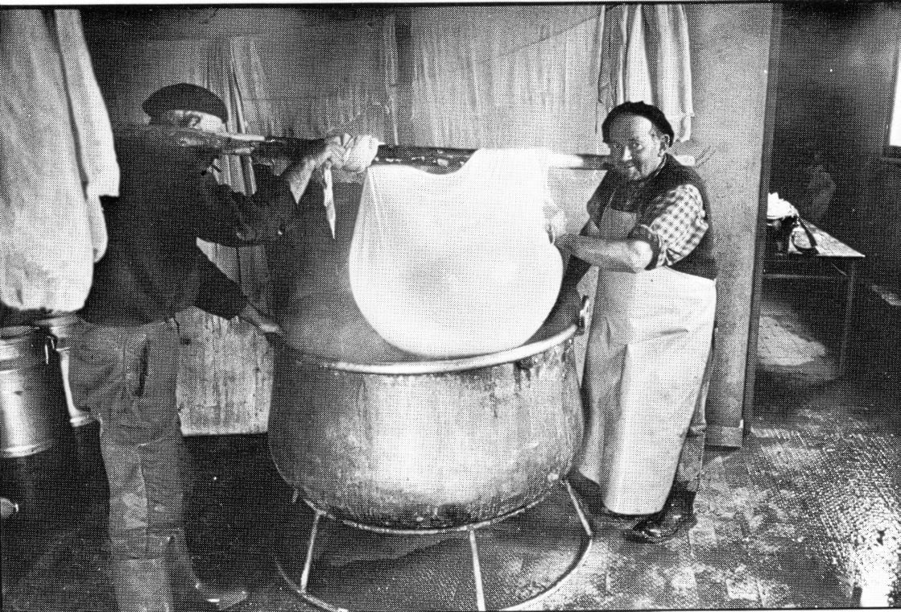
9. Androuet
Country: France
Type of business: Dairy products
Type of activity: Corporate videos
It was in 1909 that the Androuët saga began. Henri, founder of the company formerly located in rue d'Amsterdam, had the idea of introducing cheeses from all regions of France to Parisians who were not necessarily aware of the wealth of cheeses from their country.
It wasn't until the 1920s, when the fame of the Androuët house with its unique range of more than a hundred cheeses became so great, that Henri Androuët had the good idea to open a tasting cellar which became the Parisian meeting place for all great cheese lovers.
Through this site, we would like to pay tribute to the profession of cheese maturer, a true priesthood for the men and women of our company. Ripening a cheese is a matter for specialists: it is a matter of bringing the cheese to maturity so that it fully expresses all its aromas. A real game of patience, maturing requires constant supervision and a suitable environment. The whole nobility of this profession is to mature the cheese.
Website: https://androuet.com/
MARHER - Heritage Marketing for competitiveness of Europe in the global market
Project Reference Number: 2019-1-DK01-KA202-060273
Key Action 2 - Cooperation for innovation and the exchange of good practices

Slide 24
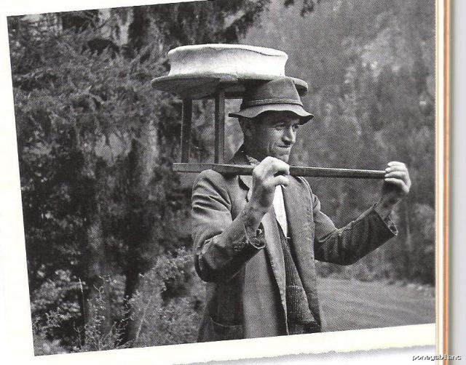
9. Androuet
Country: France
Type of business: Dairy products
Type of activity: Corporate videos
Androuet is a Cheese factory that was born to maintain the tradition of gourmet cheeses and the permanent quest of quality are essential for us. This requirement implies defend and enrich a unique expertise in both the art of refinement in the selection of producers and farm cheeses. This rich relationship completes the nobility of our business.
The work of the Heritage Marketer can also be seen in the section where it is told why the company wanted to create an academy. The company emphasizes the importance for them of continuous training and enhancement of those people who work in the dairy field. For this reason, they decided to create a free training course.
Website: https://androuet.com/
MARHER - Heritage Marketing for competitiveness of Europe in the global market
Project Reference Number: 2019-1-DK01-KA202-060273
Key Action 2 - Cooperation for innovation and the exchange of good practices

Slide 25
9. Androuet
Country: France
Type of business: Dairy products
Type of activity: Corporate videos
Finally, the company had a great and original idea: organize animation by a cheese professional who is passionate about his profession and who will make guests discover a world of pleasure and attachment to gastronomic heritage. Androuet organizes tasting parties, cheese and wine courses, in French or English, with the right mix of expertise, service, conviviality and humour to welcome friends, foreign visitors, and clients.
Website: https://androuet.com/
MARHER - Heritage Marketing for competitiveness of Europe in the global market
Project Reference Number: 2019-1-DK01-KA202-060273
Key Action 2 - Cooperation for innovation and the exchange of good practices

Slide 26
10.Dubuisson
Country: Belgium
Type of business: Brewery
Type of activity: Corporate museum
The history, values and authenticity of the company can be captured during visits. The museum offers a firsthand experience, enabling the customer to see and listen to the Dubuisson history directly and to be somehow involved in the brewery’s processes and products, thus again increasing the personal involvement. Moreover, many objects in the old brewing hall bear witness to the past and the guide will no doubt regale to the visitors amusing anecdotes from the rich brewing history.
Website: https://www.dubuisson.com/
MARHER - Heritage Marketing for competitiveness of Europe in the global market
Project Reference Number: 2019-1-DK01-KA202-060273
Key Action 2 - Cooperation for innovation and the exchange of good practices

Slide 27
10.Dubuisson
Country: Belgium
Type of business: Brewery
Type of activity: Corporate museum
In the Dubuisson web site they have also a blog where the latest news about the company are collected and where some recipes based on their beer are released.
The company, besides talking about history and values, has been able to innovate over the years, creating a museum with interactive experiences. The Dubuisson Beerstorium create an interactive experience at the heart of the history of the Brasserie Dubuisson and the universe and secrets of its beers. The visit will plunge the visitors into the castle of Ghyssegnies, where it all began for the Brewery in 1769.
Website: https://www.dubuisson.com/
MARHER - Heritage Marketing for competitiveness of Europe in the global market
Project Reference Number: 2019-1-DK01-KA202-060273
Key Action 2 - Cooperation for innovation and the exchange of good practices

Slide 28
10.Dubuisson
Country: Belgium
Type of business: Brewery
Type of activity: Corporate museum
Brasserie Dubuisson was founded in 1769 by Joseph Leroy, an ancestor on the maternal side of the current owner, Hugues Dubuisson.
Brasserie Dubuisson is an authentic, traditional Belgian brewery, thanks to its many years in business, its proven authenticity and the values that are in the forefront of the way it conducts its business. Brasserie Dubuisson is considered as authentic and important as Belgium’s famous Trappist breweries.
Furthermore, this brewery is able to lay claim to a badge of honour that is envied by many of its rivals: it is the oldest brewery in Wallonia.
Website: https://www.dubuisson.com/
MARHER - Heritage Marketing for competitiveness of Europe in the global market
Project Reference Number: 2019-1-DK01-KA202-060273
Key Action 2 - Cooperation for innovation and the exchange of good practices

Slide 29
11. Columbus
Country: Italy
Type of business: Processing of special steel tubes for bicycles
Type of activity: Thematic publication
The story of the most famous steel tubes manufacturer in the world for cycling application began in 1919 when Angelo Luigi Colombo founded his steel mill, named after him A.L. Colombo. In the Thirties, Columbus was created to specifically manufacture steel tube for bicycles, designing the first reinforced tubes with a tapered thickness in molybdenum chrome steel, a new feature for cycling, as well as the first cold-rolled elliptical fork blades.
Since the foundation of the A.L. Colombo, on 22 November 1919, Angelo Luigi Colombo chose the path of uniqueness and pursued it by differentiating itself for production technology and product: special steels, special processes for special pipes. It produced precision tubes that form the backbone of seaplanes and vehicles, that is the core of steel tubular furniture, which in sport translates both in bicycle frames as well as ski poles. Innovation and uniqueness are the key to the company: research and testing, product diversification and customer care.
Website: https://www.columbustubi.com/en/
MARHER - Heritage Marketing for competitiveness of Europe in the global market
Project Reference Number: 2019-1-DK01-KA202-060273
Key Action 2 - Cooperation for innovation and the exchange of good practices

Slide 30
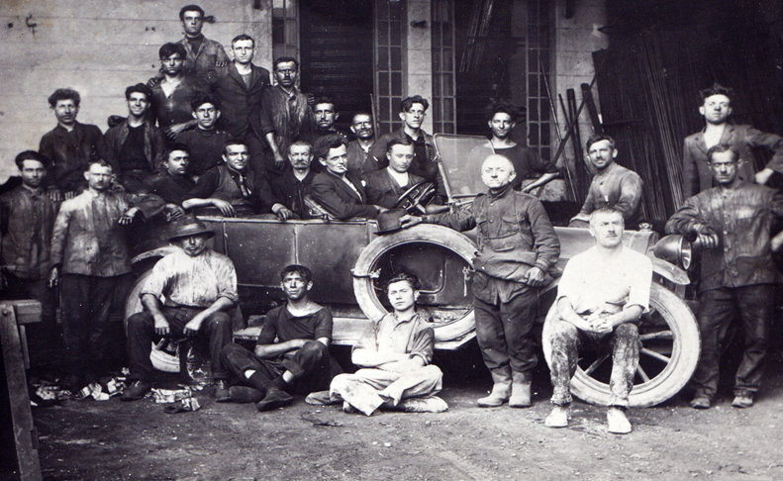
11. Columbus
Country: Italy
Type of business: Processing of special steel tubes for bicycles
Type of activity: Thematic publication
Columbus celebrates its first 100 years’ anniversary today, with a dedicated production (CENTO series), a deep re-organization of its archives to make them easily accessible from remote and a variety of venues, including exhibitions and meetings to promote even better such a valuable heritage of industrial design and industrial culture and history.
Website: https://www.columbustubi.com/en/
MARHER - Heritage Marketing for competitiveness of Europe in the global market
Project Reference Number: 2019-1-DK01-KA202-060273
Key Action 2 - Cooperation for innovation and the exchange of good practices

Slide 31
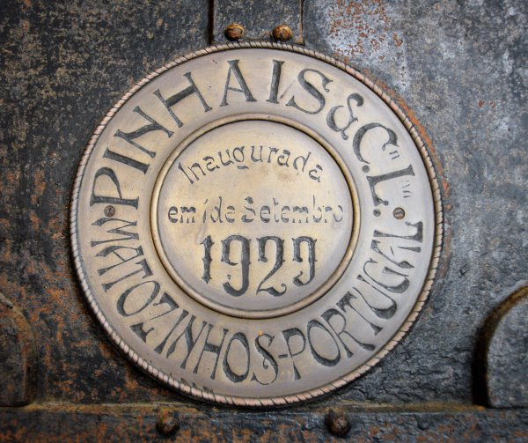
12. Pinhais
Country: Portugal
Type of business: Production of canned fish
Type of activity: Factory tours
Pinhais & Cia, founded in 1920 by four partners, has expanded over a century while maintaining true to a traditional manufacturing procedure that ensures the greatest quality and flavor of its goods. All of our communication is founded on our history. This is our unique selling proposition. Pinhais do not sell to the general public or through retail chains.The distinction stems from the careful selection and purchase of only the finest fish, the freshness of its ingredients, the generations-old (and secret) recipes, and, of course, the small - but significant - details that only their dedicated collaborators are aware of after handling the product for decades.
Website: https://www.conservaspinhais.pt/en/home
MARHER - Heritage Marketing for competitiveness of Europe in the global market
Project Reference Number: 2019-1-DK01-KA202-060273
Key Action 2 - Cooperation for innovation and the exchange of good practices

Slide 32
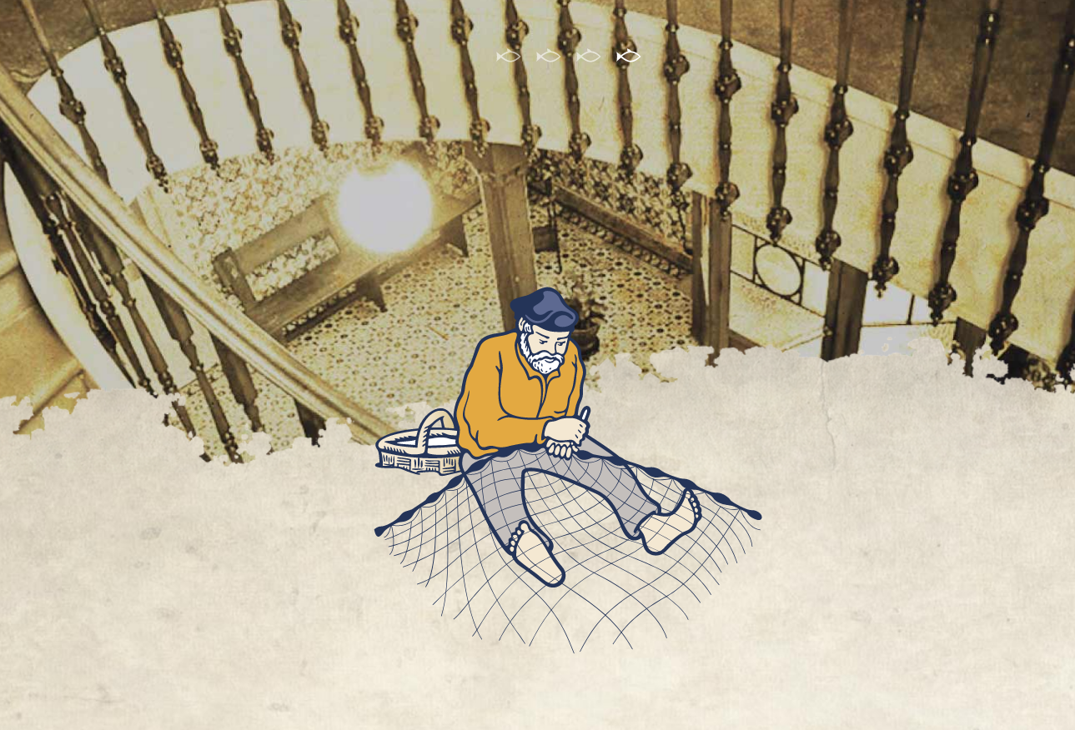
12. Pinhais
Country: Portugal
Type of business: Production of canned fish
Type of activity: Factory tours
The goal of Heritage Marketing is to legitimize the Artisanal Sardine's unique method. Each and every can manufactured is a one-of-a-kind masterpiece. The amount of stages necessary to make the preserves is around triple that of a modern retail product, resulting in a far more intricate, real, and superior-quality product. All of this focused hand preparation process flows to culminate in an outstanding product worthy of life's greatest moments, from the selection of only the best fish to the use of the freshest ingredients, the specific cooking style, and the use of only 100 percent refined olive oil.
Website: https://www.conservaspinhais.pt/en/home
MARHER - Heritage Marketing for competitiveness of Europe in the global market
Project Reference Number: 2019-1-DK01-KA202-060273
Key Action 2 - Cooperation for innovation and the exchange of good practices

Slide 33
Links:
https://glasetshuslimmared.se/
https://www.johannesfog.dk/
http://www.ciuciuvini.it/ (ENG)
https://brokenships.com/ (ENG)
https://little-bee-fresh.de/tante-ida/
https://rhanders.com/ (ENG)
https://inkaras.lt/
http://www.pergale.lt/en/products/confections (ENG)
https://androuet.com/ (ENG)
https://www.dubuisson.com/
https://www.columbustubi.com/en/ (ENG)
https://www.conservaspinhais.com/en/home (ENG)

